Slide 1
Recommender Systems -Konstantinos Stefanidis
By,
Brindhapriya Babu
Chethan Kashyap BM

Slide 2
OBJECTIVE:
The main objective of this assignment is to find a way to calculate sequential recommendations while considering disagreements and satisfactions between the users into account in each iteration.
We will be using the paper method with some modifications for calculating alpha score.
IMPLEMENTATION:
Calculate User satisfaction
User satisfaction = sum of group recommendation scores
--------------------------------------------------
sum of user recommendation scores
Calculate Group satisfaction
Group satisfaction = Mean (satisfaction of all users in the group)

Slide 3
Calculate Kendall tau disagreements between users so that it will help us understand that how disagreements among the users affect the overall satisfaction.
Consider 3 users (A,B,C)
Calculate KT between all users i.e., KT (AB) , KT(BC), KT(AC)
Calculate mean of KT disagreements between users
i.e., Mean ( KT (AB) , KT(BC), KT(AC) )
Calculate KT disagreements between each user and group
KT (AG), KT(BG), KT(CG)
where A,B,C are user’s movie recommendations,
G is group recommendations.
Calculate mean of KT disagreements between users and group
i.e., Mean ( KT (AG) , KT(BG), KT(CG) )
Calculate alpha ( α )
α = ( Mean ( KT (AB) , KT(BC), KT(AC) ) ) – ( Mean ( KT (AG) , KT(BG), KT(CG) ) )

Slide 4
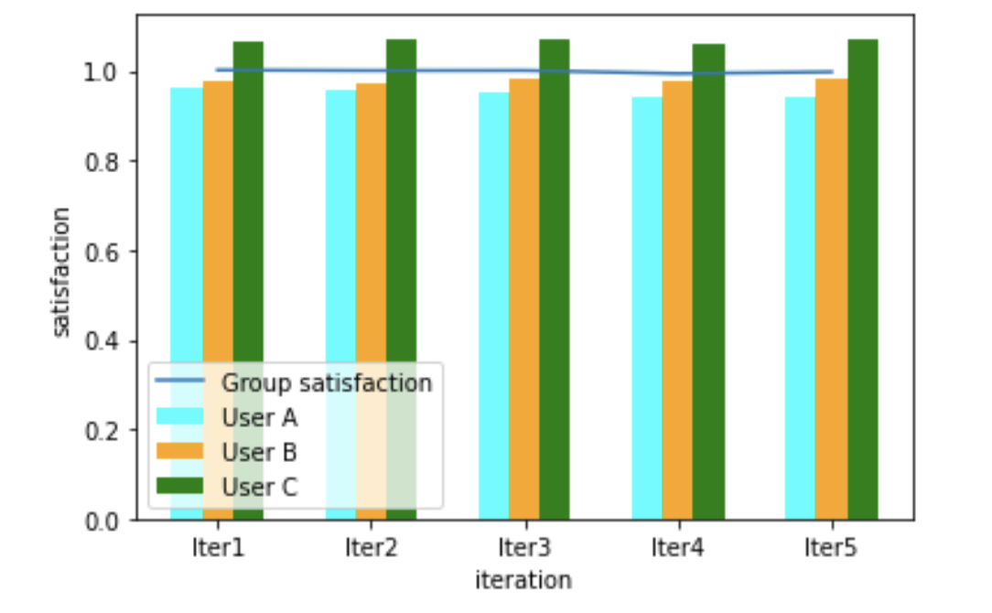
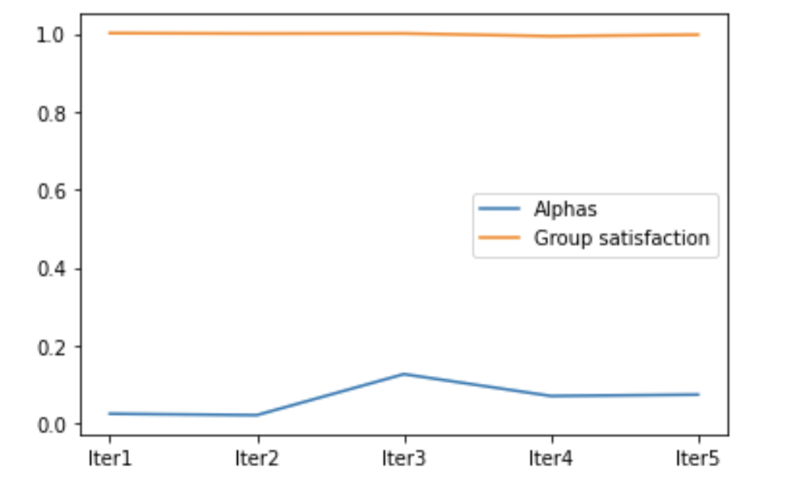
The final movie score is calculated of the particular iteration is calculated as below
movie score = ( (1- α ) * avgScore ) + (α * leastScore)

Slide 5
THANK YOU

